Slide 1
Controlled Substances (CS) and
CS for the Treatment of Pain
Use, Misuse, Abuse, Tolerance, Dependence, and Addiction
What Do We Do Now?
Joe Hardy, MD
Associate Professor of Primary Care
Touro University Nevada
Nevada State Senator, District 12

Slide 2
Disclosures and Disclaimers
Full-time Associate Professor Touro University of Nevada, College of Osteopathic Medicine since Nov. 1, 2012
Nevada State Senator District #12 since 2010
Member AAFP, NAFP, CCMS,NSMA
Fellow ABFM
Veteran USAF, Major
No other outside income affiliations
31.5 hours of CME since Nov. 28th on Addictions and Treatments

Slide 3
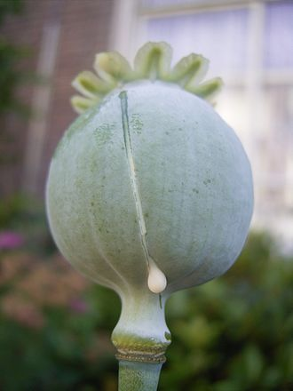
Opium: 5000 years of relieving human pain and suffering
Opium and opiates have been used to relieve pain since at least 3500 BCE
The first opiates were derived from the poppy plant
Opiates bind to receptors in the brain and spinal cord
Opiates exhibit tolerance, dependence, and can be addictive
All opiates can cause death by respiratory depression
Opiates have long been recognized as the premier pain reliever in human beings and other mammals
Opioids is a modern term that refers to any molecule that binds to opiate receptors, whether the drug is synthetic or natural from the poppy

Slide 4
More Recent Origins of Pressure on Providers to use CS for pain
Fifth Vital Sign = Pain
Patient Satisfaction required for reimbursement
Unhappy patients in ER because not received sufficient opiates
  ER Physicians Pressured to Prescribe Opiates to increase patient satisfaction ratings
And Primary Care Physicians similarly affected

Slide 5
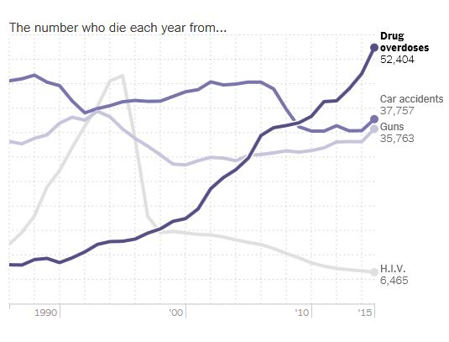
U.S. Data

Slide 6
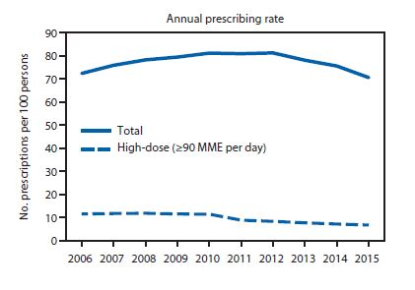
U.S. DHHS/ CDC July 7, 2017

Slide 7
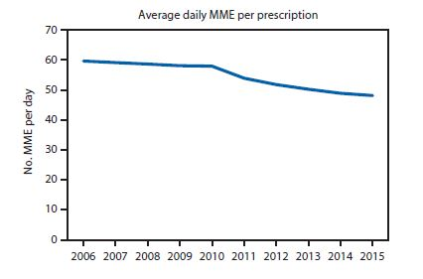
U.S. DHHS/ CDC July 7, 2017

Slide 8
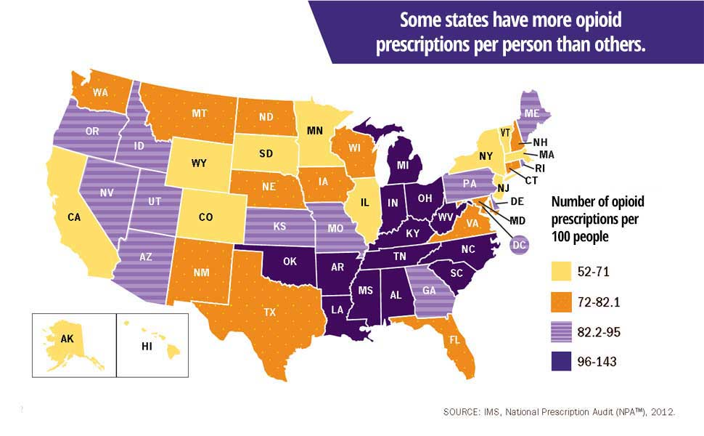
Nevada is not among highest opioid prescribing states
While Nevada was previously among the high opioid prescribing States, as of 2012, we were not even in the top ten States
In 2017, 365 Nevadans died with “opioid” listed as one of the causes of death– about one per day
In 2017, about 10 Nevadans died with a prescription opioid as the ONLY cause of death
17 Nevadans die per day of heart disease
14 Nevadans die per day of cancer

Slide 9
CDC Data, 2011-2016: U.S. up; Nevada down

Slide 10
Since 2011, how is Nevada doing in addressing the “opioid crisis” compared to the US as a whole?
Nevada is doing better than the U.S. as a whole and substantially better than many areas in the U.S. (Maine, West Virginia, western Pennsylvania)
Moreover, Nevada prescribers show continued progressive improvement in number and dosage of CS opioid prescriptions since 2011

Slide 11
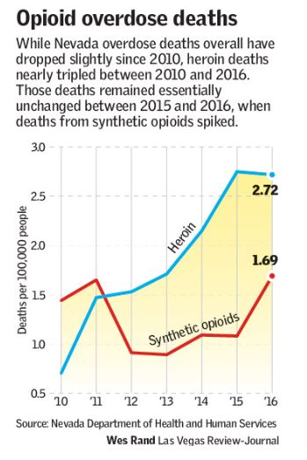

Slide 12
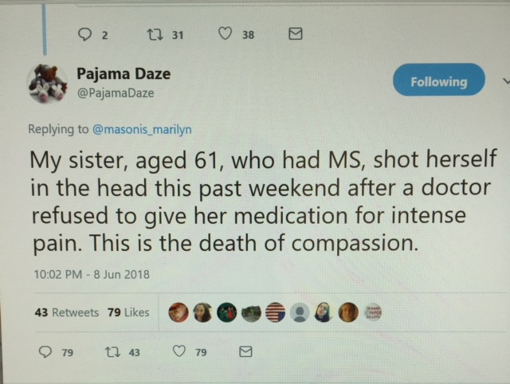
Anti-Opioid legislation unintended consequences
Anti-Opioid Legislation associated with decreased access to pain management
Anti-Opioid Legislation does nothing to address the fentanyl and heroin epidemic that is the major case of opioid deaths
Many physicians have stopped or drastically decreased prescribing opioids
Multiple anecdotal reports of patients being unable to obtain pain medication

Slide 13
Notes:
The average rate of prescriptions is 87.5/100 residents. The Highest counties for prescribing are Nye, Mineral, and Storey.

Slide 14
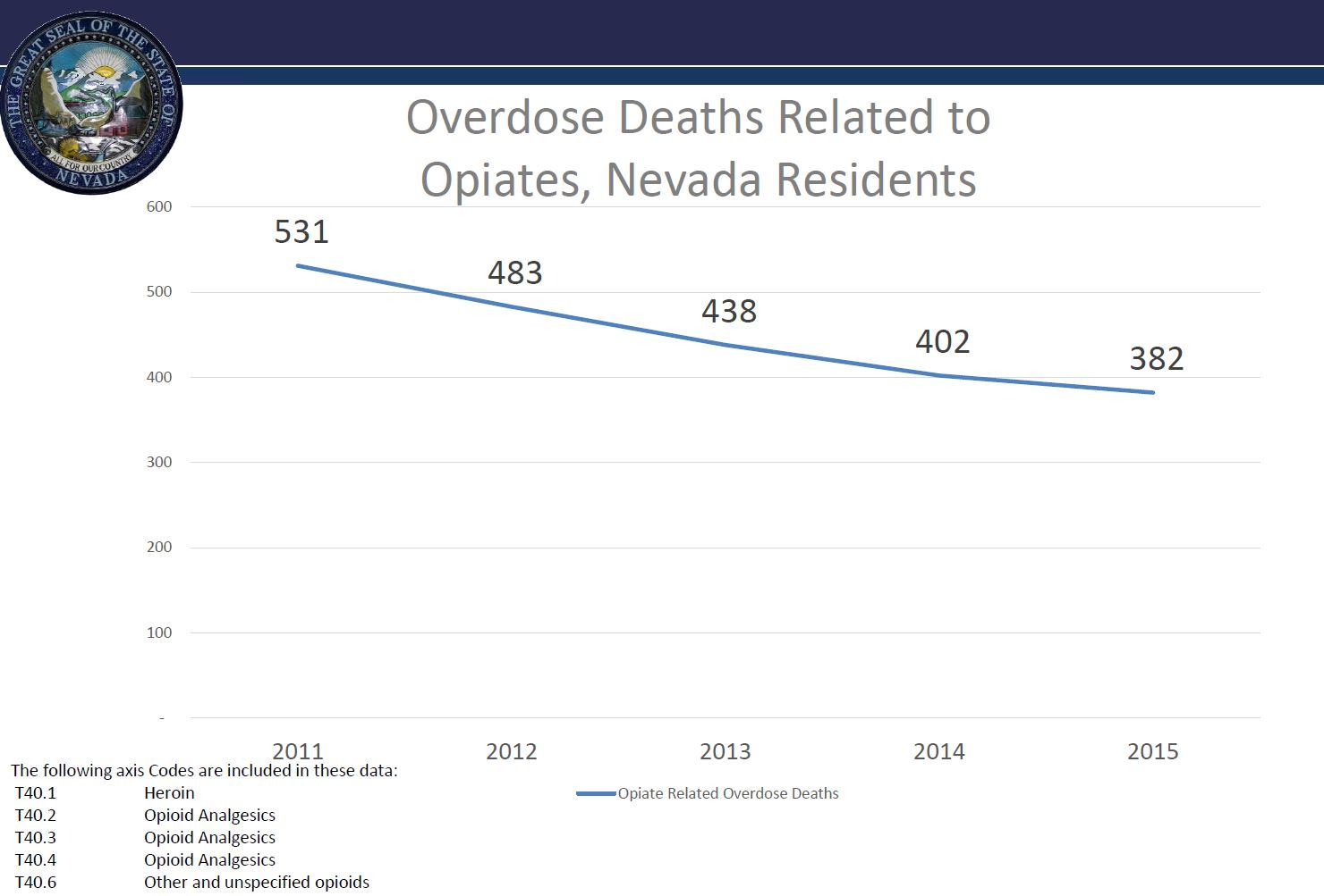

Slide 15
Legislative Enactments
SB 288 (2015)
  PMP registration and mandatory checking every 6 months for profile
SB 459 (2015)
  7 days acute pain
  Chronic pain
AB 474 (2017)
  All specialties required
  All Controlled Substances, II thru IV (V)
  Multiple new mandates, unique investigation process, different requirements/discipline depending on profession

Slide 16
What has been the effect on opioid prescription writing since the passage of AB474?
DHHS data from Jan 1, 2017 thru May 2018:
Opioid prescriptions with less than a 30 days supply decreased by 48%, the great majority of the decrease after passage of AB474.
Opioid prescriptions with greater than or equal to a 90 days supply decreased by 38%, the great majority of the decrease after the passage of AB474.
All Nevada counties observed a decrease in both the number of and rate of opioid prescriptions.

Slide 17
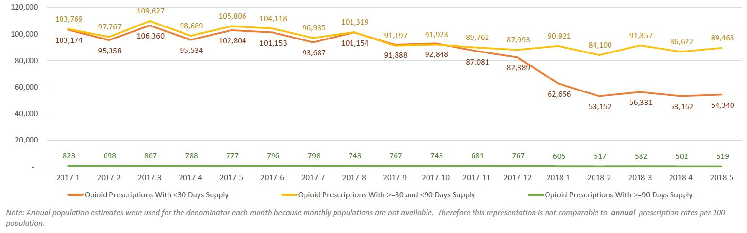
DHHS Data on Opioid Prescriptions Jan 2017 – May 2018
AB474 Passed
AB474 effective against prescribers

Slide 18
DHHS data from Jan 1, 2017 thru May 2018
The number of prescriptions and unique patients receiving less than 50 MMEs per month decreased 27% from January of 2017 to May of 2018.
The number of prescriptions and unique patients receiving 50 MMEs to 90 MMEs per month decreased approximately 44% from January of 2017 to May of 2018.
The number of prescriptions and unique patients receiving greater than 90 MMEs per month decreased 32% from January of 2017 to May of 2018.
The number of individuals who were co-prescribed Opioid and Benzodiazepines during the same month also decreased significantly, by 41% in Nevada overall.

Slide 19
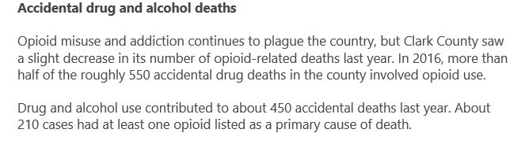
LV Review Journal article February 2018
2016 – 550 drug deaths involved opioid use
2017 – 210 drug deaths had at least one opioid as a cause of death
This was characterized as a “slight decrease” in the number of opioid-related deaths – “fake news” ??

Slide 20
MISUSE and
Abuse in
Nevada

Slide 21
Methods of Diversion (Mike Lewis, DEA, 2012)
Practitioners/Pharmacists
  Illegal distribution
  Self abuse
  Trading drugs for sex
  Retail pharmacies
  Manufacturing / distribution
  facilities
Pharmacy/Other Theft
  Armed robbery
  Burglary (Night Break-ins)
  In Transit Loss (Hijacking)
  Smurfing
Customers/ Drug Seekers
  Drug rings
  Doctor-shopping
  Forged / fraudulent /altered
  prescriptions
  The medicine cabinet
Employee pilferage
  Hospitals
  Practitioners’ offices
  Nursing homes
Pain Clinics
The Internet

Slide 22
Prescription Fraud (Mike Lewis, DEA, 2012)
Fake prescriptions
  Highly organized
  Use real physician name and DEA Registrant Number
    Contact Information false or “fake office”
    Organizations set-up actual offices with contact information and staff (change locations often to avoid detection)
  Prescription printing services utilized
    Not required to ask questions or verify information printed
    Use of out of state internet based printing services
    Licensing of printing services in some states to reduce fraud
Stolen prescriptions
  Forged
  “Smurfed” to large number of different pharmacies

Slide 23
Emerging Trends in Nevada (Mike Lewis 2012)
Counterfeit pharmaceuticals
  Often obtained through internet sources, both domestic and foreign
  Internet sources advertise on Business-to-Business (B2B) sites, such a Alibaba.com, Tradeboss.com, etc.
  Substances usually obtained through foreign wholesalers
  Substances contain wide variety of ingredients, some toxic, or active ingredients in insufficient levels
“DEA has no legal authority over counterfeit pharmaceuticals; however, assists agencies, upon requests.

Slide 24
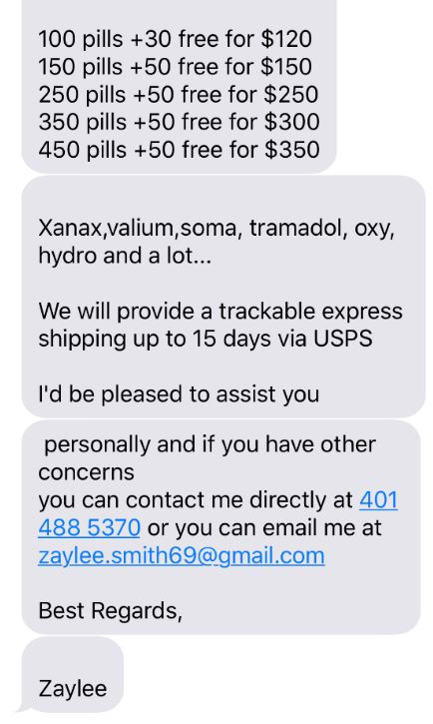
Internet sources of Controlled Substances

Slide 25
Article from NPR, May 2018, quoting former Dept. of Homeland Security official Juliette Kayyem:
“It is all too easy to get drugs delivered right to your mailbox. The chances of getting caught are minimal.”
US Postal Service received 1.3 million inbound packages from overseas a day, and manages to inspect about 100 of them.
US Customs Chicago O’Hare International Port Director, Matthew Davies, states that it is “like looking for a needle in a haystack.”

Slide 26
A Legal source of Controlled Substances
(source: Nevada Patients)
Mexico – border towns
  Some Pharmacies sell without a prescription
  Some Pharmacies will require a prescription from a Mexican physician
    Pharmacist will recommend a nearby physician
    The physician charges a fee for the prescription
    The pharmacist fills the prescription
      The price charged the American “gringo” is greater than for a Mexican national, but less than street prices in the U.S.
The U.S. citizen crosses the border with a legal medication obtained from “medical care” rendered in Mexico

Slide 27
Diversion of Legal Prescription
Of those at highest risk for overdose, using prescription;
  27% get their opioids using their own prescriptions
  26% get them from friends or relatives for free
  23% buy them from friends of relatives
  15% buy them from a drug dealer
Abuse of legal prescriptions, and diversion of legal prescriptions is a problem
Source: Nevada DHHS, 2016
Notes:
Reports from the CDC tell us that diversion of controlled substance prescriptions continues to be a problem,
Of those most at risk for prescription drug abuse overdose (those using prescription opiates nonmedically for 200 days or more)

Slide 28

Litigation on behalf of patients
Professional negligence claims for addiction and misuse of medications
Professional negligence claims for involuntary taper of opioid medications
Professional negligence claims for inappropriate termination of the physician-patient relationship
Professional negligence claims for inadequate analgesia
Professional negligence claims for inappropriate use of medication alternatives to opioids (NSAIDS)

Slide 29

Other theories of liability
Involuntary medication tapers may violate patient informed consent
Involuntary tapers as “Detox” may violate federal Controlled Substance Act
Government mandated involuntary medication tapers may amount to human experimentation
Stephen Zeigler, JD, PhD Professor of Law Northeastern University

Slide 30
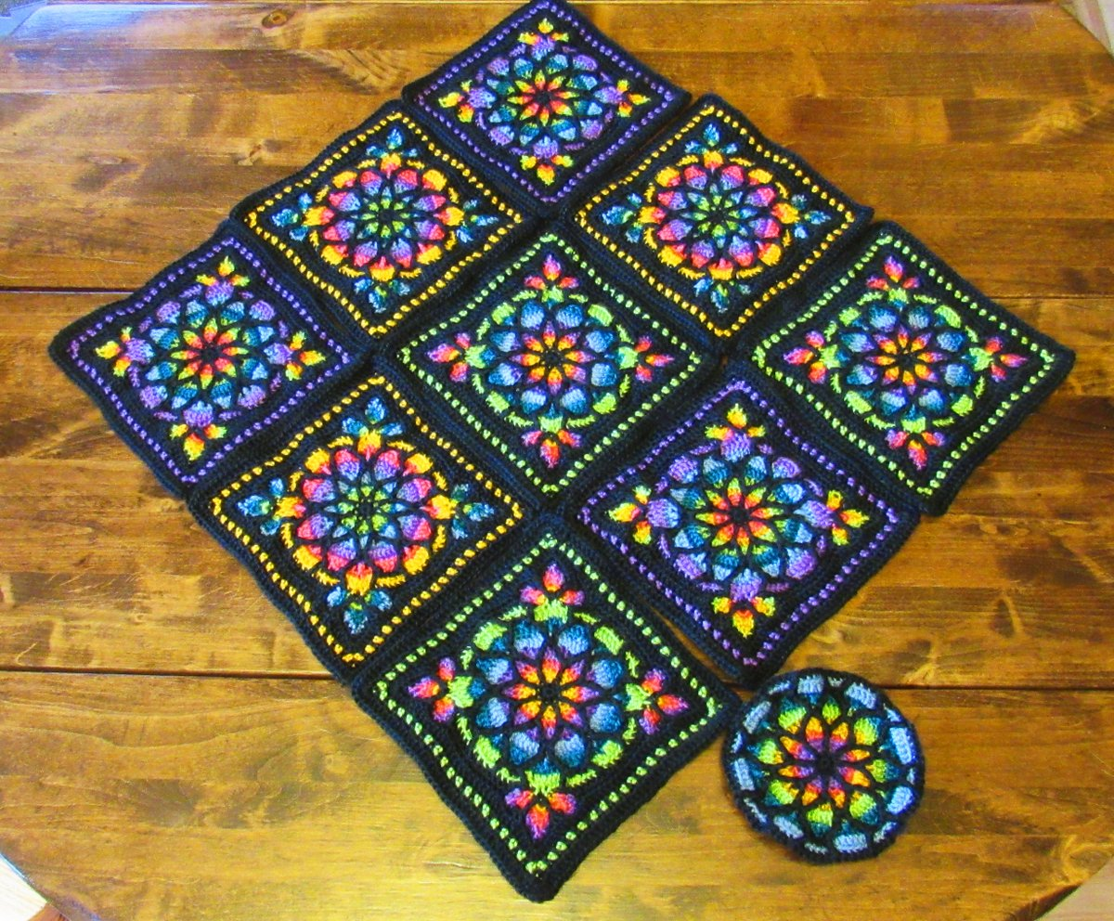
Has AB 474 and other anti-opioid legislation harmed patients?
These are extremely difficult times for chronic pain patients
Unprecedented animus and unlawful discrimination against the disabled and chronically ill
Patient suicide due to inadequate analgesia is constant concern
Online communities provide support
  Facebook, Twitter groups
  Many have made quilts and other crafts as symbols of solidarity and hope
Advocacy groups are forming nationwide

Slide 31
TOLERANCE,
DEPENDENCE,
ADDICTION and
TREATMENT

Slide 32
Anaphylaxis versus Opioid Overdose Deaths
Approximately 2500 people died in USA 1999-2010 from Anaphylaxis
  How many have written or recommended “Epipen” for patients?
More than 64,000 drug overdose deaths in 2016 in the USA.
  Reference: National Institute on Drug Abuse, drugabuse.gov
  More than 300 people died in Nevada in 2015 from drug overdose with opioids as a cause of death.
  How many have written or recommended Naloxone (Narcan)?
It seems prudent to prescribe or recommend Naloxone (Narcan) more.

Slide 33
Acute Pain: broken leg, kidney stone….
7 days or 14 days or ?
Refills or revisits
Follow up from ER in timely manner with schedules full
Worse 3 days later with “dry socket”
“Preferred” drug: nausea, and woozy with Lortab, stomach ache with ibuprofen, but “Percocet works well” – patient must be a degenerate “drugger”
  does requesting a specific controlled substance (CS) for pain indicate a “drug abuser”?
  if ER doc prescribes a CS, and patient seen 3 days later by HC provider, is prescribing more of same medication by HC provider prohibited for “ongoing treatment”?
    probably not, since the patient is not being treated by the ER doc for an “ongoing” problem

Slide 34
Chronic Pain
Stable on same dose of narcotic or benzodiazepine for years, even decades.
Functional as to ADLs (activities of daily living)
Options for Patients?
  Is prescriber at risk for continuing same medication?
  On-call physician refills of same medication prohibited?
    See AB 474, Sec. 60(1)(b) and newly amended NRS 639.23507(1)(b)
    See new BOP regulation R047-18AP – direct conflict with the established statute

Slide 35
TOLERANCE
Need more for same effect; Less effect for same dose
Occurs for effects and side effects: euphoria, sedation, respiratory depression, vomiting, analgesia
Gradual increasing dose creates high tolerance for otherwise lethal doses.
Withdrawal symptoms: occurs when stopping or reducing the opioid
One last same-dose-fix is just that, for person who celebrates sobriety

Slide 36
Physical DEPENDENCE (not addiction)
Physiologic change or adaptation in an organism in response to repeated administration of a drug
Opioid Use Disorder is a disease with above criteria for pathologic use or addiction.

Slide 37
ADDICTION, aka substance use disorder
Per SIRI: the fact or condition of being addicted to a particular substance, thing or activity.
Wikipedia: State characterized by compulsive engagement in rewarding stimuli despite adverse consequences
NIH: …a chronic, relapsing brain disease that is characterized by compulsive drug seeking and use, despite harmful consequences.
ASAM (2001): A primary, chronic, neurobiological disease, with genetic, psychosocial, and environmental factors influencing its development and manifestations….impaired control…compulsive use…despite harm…and craving.

Slide 38
Opioid Overdose causes Respiratory Depression
Unusual to be just one opioid causing sufficient respiratory depression to cause death
Opioid overdose commonly associated with alcohol
Aggravated by co-administration of a benzodiazepine
Opioid + benzodiazepine + alcohol severe respiratory depression
Sadly may occur in a rehabbed person who has lost tolerance, and does “one last fix” of the same dose as previously used, resulting in respiratory depression and death
New illicit pills and heroin now commonly laced with fentanyl death

Slide 39
Substance Use Disorder (SUD):
Stigma less using:
Opioid, OUD
Alcohol, AUD
Tobacco, TUD

Slide 40
TREATMENT
The Waiver from the Harrison’s Act 1914
No narcotic can be used to treat a narcotic addiction without a waiver
“X” in front of DEA number instead of first initial - for health care providers who have earned the waiver
Those with waiver - two DEA numbers
Drug Abuse Disorder Act (DATA 2000) created the waiver for the buprenorphine and Suboxone (buprenorphine and naloxone) to be used for addiction treatment

Slide 41
Methadone: for pain or for addiction
Methadone can be prescribed for treatment of addiction only thru opioid treatment centers by special licensees.
Long acting pain medication but respiratory depression effect longer than pain relieving qualities.
Patient must go to the center for the treatment, no script to take home.
*higher risk of prolongation of the QTc interval assoc w/ TdP
Schedule II

Slide 42
Buprenorphine
Schedule III Partial agonist Advantages for Acute Pain
Twelve reasons for considering buprenorphine as a frontline analgesic in the management of pain. J Support Oncol. 2012 Dec; 1096):209-19
Works for cancer pain, neuropathic pain, less constipation, ceiling effect on respiratory depression, less cognitive impairment, not immunosuppressive like morphine or fentanyl, does not cause hypogonadism, no QT prolongation*, effective in elderly, safe in renal failure and for those on dialysis, and withdrawal is milder with lower abuse liability than full agonists.
No waiver required if used to treat pain; waiver is required if used to treat addiction.

Slide 43
Opioid Dependency:
Suboxone, Zubsolv, Bunavail all Schedule III
Buprenorphine/naloxone - all sublingual tab or buccal film
Designed to prevent diversion/IV use
Naloxone poorly orally absorbed
Naloxone inclusion prevents melting down abuse
Buprenorphine monotherapy recommended for long-acting opioid induction

Slide 44
Narcan (naloxone) nasal spray
Use in suspected overdose; will cause acute withdrawal if on opioid.
Not a controlled substance per Controlled Substance Act
Available with or without a prescription
Two nasal spray applicators
Around $ 130
Medication does not last as long as the respiratory depression from the opioid – therefore, stay with patient until respiration depression recurs, and then use the second nasal spray

Slide 45
Naloxone – (IM) opioid antagonist
Use in suspected overdose; will cause acute withdrawal if on opioid.
Not a controlled substance per Controlled Substance Act
Available with or without a prescription
Generic (IM) is about $40 (needle with syringe involved; must inject)
Insurance will only pay if prescribed for the person needing it
Must take patient to the hospital after use because naloxone also wears off and the respiratory depression recurs
  Other substances may be involved which are not ameliorated by naloxone, so ER hospital evaluation is prudent

Slide 46
Evzio (naloxone) auto-injector
two auto-injectors in 1 carton
obtainable without a prescription
cost - $ 3,850 (with coupon)
nice looking packaging

Slide 47
Naltrexone: ReVia, Vivitrol, Depade
IM: 380 mg q 4 weeks option for maintenance of abstinence of opioids and ETOH.
  Caveat- only after negative naloxone challenge – ie., no withdrawal
PO: 50 mg daily to treat AUD - maintenance of abstinence
Embeda: morphine/naltrexone - chronic severe pain
Troxyca ER: morphine/naltrexone - chronic severe pain
Contrave: bupropion/naltrexone - for Obesity as an adjunct to diet and exercise

Slide 48
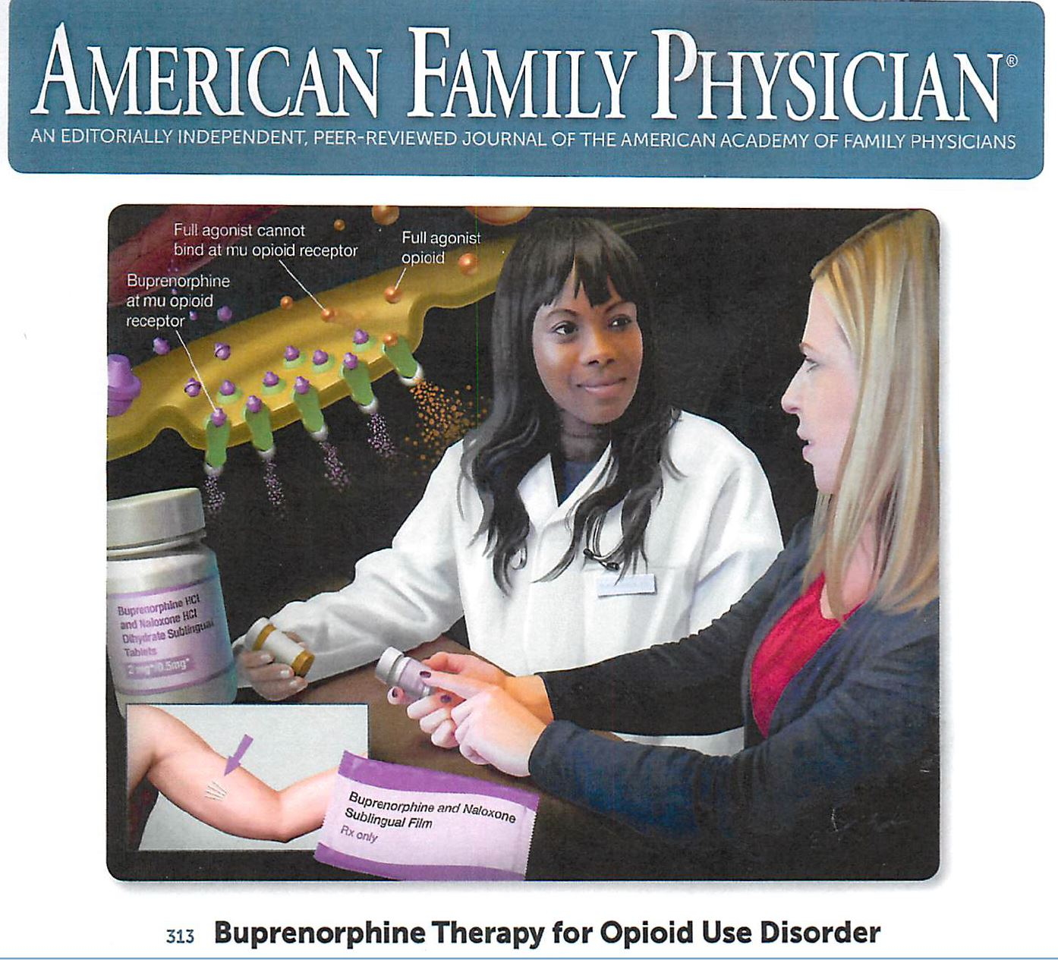

Slide 49
People fail rehab 50% to 90% of time
Do not discharge the patient
Work with the patient like you would with any other patient with a chronic disease
Confidentiality of the treatment even from subpoena
  See new federal regulations: 42 CFR part 2 providing even greater privacy protections
Use MAT (medication assisted treatment) for however long it is needed

Slide 50
BTW: Schedule V drugs mandate PMP inquiry before prescribing
Examples of Schedule V controlled substances:
Low dose codeine common in cough medications
Lomotil
Lyrica
Phenergan with codeine
Vimpat: lacosamide for anticonvulsant

Slide 51
Not Scheduled
Rozerem: melatonin agonist for sleep
Tessalon: for cough
Antidepressants
Antiepileptics
Antihistamines
Acetaminophen
NSAIDs
Earplugs and eye masks
Ice cubes and moist heat

Slide 52
New Regulations and pending regulatory actions
Board of Pharmacy
  2015 Naloxone available by Rx to family or friend
  2017 over the counter Naloxone
Board of Medical Examiners
  Subcommittee on R100-17P recommended to NBME Board to rescind proposed regulation 100-17P
  New proposed 2 hour CME requirements for dispensing licensees only
Board of Osteopathic Medicine, Nursing Board, Podiatry Board
  Regulations mandating 2 hour training/CMEs for all licensees; no additional punitive actions
Nursing Board - APRNs
  Exec Dir email mandating 2 hrs CME required for renewal; regulation in process
Dental Board indicated intent to mandate 2 hour training/CMEs without new additional punitive actions

Slide 53
Do Something
Get DATA 2000 waiver: 4 hrs live with 4 hours online OR 8 hours online
  Offer MAT with buprenorphine or Suboxone in your practice
Get naloxone for office IM or for Nasal spray, and show people how to use
Write naloxone for every opioid patient (insurance coverage)
Limit acute pain opioid scripts to 7 days
Refer to pain doctor or other type provider for another opinion if patient not responding as expected, or if you suspect diversion
Lobby patients to fix the flaws in AB474 in the next legislative session
  Be an early adopter of a “change in the culture of medicine” which has heretofore avoided involvement in Legislative matters
  The reason to be involved is not for what YOUR legislator can do FOR you, but what your legislator can do TO you.
  With AB 474, you have been “TO’d”

Slide 54
Fix the Bill next session and proposals now for contemplations of interim salutatory regulations:
Focus on chronic pain; drop the mandates for short term acute and post-op pain (see the Guidelines of the Federation of State Medical Boards)
Facilitate partner coverage same CS prescription, and covering physician same CS prescription, after checking with PMP
Facility seamless transfers of patients from one provider to another minimizing repetitive paperwork or processes
Hospice, palliative care, end of life care, cancer pain – all should be carve-outs as recommended by Federation of Medical Boards Model Guidelines for the Chronic Use of Opioids for Pain Treatment; add exceptions to the law for individual emergencies and public health emergencies
Encourage clinical judgement an individual patients and provide physician protection for such
Informed consent may be provided orally, and not necessary for subsequent physicians using same class of controlled substances
All Boards treating prescribers the same as to mandates and discipline for the use of controlled substances in treating pain
  Board of Pharmacy to promulgate regulations for the use of controlled substances for the treatment of chronic pain – in consultations with all affected Boards with discussions and testimony taken by practitioners and the public in open sessions conveniently scheduled to facilitate input; no secret sessions to develop laws – convenient, transparent, recorded Board meetings and regulations development sessions
Peer review involvement and protections for both the reviewer and the practitioner being reviewed
All Board member involvement in all stages of regulations development and approval
OPT and MAT are longer than 365 days on same medication; reasons for greater than 365 days of medication in 365 days to be noted in patient’s medical records
Use “Due Process” for inquiry, investigation, formal complaint, and disposition already in place; remove Executive Director or designee’s special authority; make Board members responsible for equitable due process
Require all health care professions Boards to meet publicly at least every other month; sessions available on the internet and recorded for later public viewing; allow at least 5 minutes for testimony in “public comment” periods of meetings
Encourage prescriber education on MAT, OPT, OMM, PT, CBT, SBIRT, and CBT; and use of Naltrexone for treatment of alcoholism and opioid addiction
Dispensing physicians only ones of MDs required to do CME, include all prescribers
Avoid “double jeopardy” with mandated attestation of compliance with all CS pain treatment statutes and regulations
Define specifically the meaning of “initial prescription” in Section 51 of AB 474
Consider the effect of “summary suspensions” (prescription of controlled substances or ability to practice) on patients of the practitioner
Licensing Boards to have substantial office presence in southern as well as northern Nevada providing full preliminary inquiry of complaints, full investigations, informal and formal hearings provided on site; Boards unable to do so to be combined so that such capability can be provided for the public as well as to licensees
Boards to act promptly on complaints with protection of the public as the primary concern

Slide 55
Options for Practitioners under AB 474
Continue to prescribe. Adapt to the new rules and regulations
Prescribe controlled substances only for NOT FOR PAIN purposes, complying with those mandates in AB 474 (no prescriptions for CS for the treatment of pain)
Continue prescribing CS for treatment of pain in patients for whom you initiated the CS treatment of pain prior to Jan 1, 2018, but do not initiate the prescription of CS to treat pain for any new patients (until AB 474 is “fixed”)
Quit prescribing controlled substances for any purpose – new or established patients; do not renew your Board of Pharmacy Controlled Substances Certificate (keep your DEA active in hopes of AB 474 “fixing”)
Refuse to supervise residents or PAs due to the added liability under vicarious liability and respondeat superior legal principles
Move to another State with less onerous rules on the prescription of controlled substances (consider nearby Utah and Arizona; and Idaho, Montana, and even California)
Do not come to Nevada (too late!)

Slide 56


