Slide 1
Controlled Substances (CS) Mandates, including amendments in AB 239 of 2019 (effective June 3, 2019)
Weldon (Don) Havins, MD, JD, LLM (Health Law)
Professor and Director of Medical Jurisprudence
Touro University Nevada

Slide 2
DISCLOSURES
NO CONFLICTS TO DISCLOSE
Weldon (Don) Havins, MD, JD
wehavins.com
All course materials may be downloaded from this website

Slide 3
NRS 630.2535; NRS 631.344; NRS 632.2375; NRS 633.473; NRS 635.116; NRS 636.2881
Each (of the six) Board shall, by regulation, require each practitioner certified or registered to dispense CS to complete
2 hours of training relating to the misuse and abuse of CS, the prescribing of opioids or addiction during each relicensure period.
These CMEs may be used to satisfy 2 hours of any continuing education requirement.
(FYI, AB 105, effective July 1, 2017, requires 2 CME hours every four (4) years in suicide prevention.) By June 30, 2021, physicians, PAs, APRNs must comply.

Slide 4
NBME Existing Mandate to Report Violations
NRS 630.3062 The following acts, among others, constitute grounds for initiating disciplinary action or denying licensure:
6. Failure to report any person the licensee knows, or has reason to know, is in violation of the provisions of this chapter or the regulations of the Board within 30 days after the date the licensee knows or has reason to know of the violation.
NRS 630.3062 The following acts, among others, constitute grounds for initiating disciplinary action or denying licensure:
3. Making or filing a report which the licensee knows to be false, failing to file a record or report as required by law or knowingly or willfully obstructing or inducing another to obstruct such filing.

Slide 5
NBOM Existing Mandate to Report Violations
NRS 633.511(1) The grounds for initiating disciplinary action pursuant to this chapter are:
(p) Failure to report any person the licensee knows, or has reason to know, is in violation of the provisions of this chapter or the regulations of the Board within 30 days after the date the licensee knows or has reason to know of the violation.
(o) Making or filing a report which the licensee knows to be false, failing to file a record or report that is required by law or knowingly or willfully obstructing or inducing another to obstruct the making or filing of such a record or report.

Slide 6
NRS 639.23507
Practitioners treating patients for cancer, sickle cell disease, hospice, or palliative care are required to: satisfy bone fide patient rule, query PMP, obtain informed consent, which may be verbal, and issue a valid prescription.
A practitioner may issue a CS II, III, IV or an opioid in Schedule V for the treatment of a patient diagnosed with cancer or sickle cell disease or who is receiving hospice or palliative care without obtaining a patient utilization report if this will unreasonably delay care of the patient – obtain PMP later.

Slide 7
NRS 639.23507 PMP Mandate – Before initial CS prescription
Practitioner must obtain a PMP utilization report on the patient before issuing an initial prescription for a CS (II, III, IV) and at least every 90 days thereafter.
The practitioner shall:
Review the PMP (patient utilization) report, and
Determine whether the patient has been issued another prescription for the same CS for ongoing treatment; if so, the practitioner shall not prescribe the CS, unless the practitioner determines that issuing the prescription is medically necessary.

Slide 8
NRS 453.162; NRS 639.2353
Each prescription for Controlled Substances (CS) II, III, and IV must include:
DEA number of the prescriber
ICD 10 diagnosis
Fewest number of days to consume the quantity of CS prescribed; number of refills
(Example: Tylenol # 3, q. 4-6 h, 10 days. How many pills? 6 x 10 = 60)

Slide 9
Controlled Substances (CS) NOT for Pain (checklist)
Check the PMP (and every 90 days thereafter) for same CS
Review the PMP report
Determine whether the patient has been issued another prescription for the same CS for ongoing treatment; if so, the practitioner shall not prescribe the CS, unless it is medically necessary
Prescription: ICD 10 Diagnosis code; DEA # ; Minimum days to consume at maximum dosage

Slide 10
USING CONTROLLED SUBSTANCES FOR THE TREATMENT OF PAIN

Slide 11
NRS 639.235
Before issuing an initial prescription for CS (II, III, IV) for the treatment of pain, a practitioner must:
1. Have established a bone fide relationship with the patient
(a bona fide relationship between the patient and the person prescribing the controlled substance shall be deemed to exist if the patient was examined in person, electronically, telephonically or by fiber optics, including, without limitation, through telehealth, within or outside this State or the United States by the person prescribing the controlled substances within the 6 months immediately preceding the date the prescription was issued)

Slide 12
NRS 639.23911
Before issuing a prescription for a CS (II, III, IV) for the treatment of pain, a practitioner must:
2. Establish a preliminary diagnosis of the patient and a treatment plan tailored toward treating the pain of the patient and the cause of that pain;
3. Document in the MR the reasons for prescribing the CS instead of an alternative treatment that does not require the use of a CS;

Slide 13
NRS 639.23911, NRS 639.23912
Before issuing an initial prescription for CS (II, III, IV) for the treatment of pain, a practitioner must:
4. Perform an evaluation and risk assessment which must include:
a. Obtaining and reviewing a relevant medical history
b. Conducting a physical exam directed to the source of the patient’s pain and within the scope of practice of the practitioner
If the prescription is for a quantity of a CS II, III, or IV that is intended to be used in not less than 30 days,
i. Making a good faith effort to obtain and review any MRs from any other provider who have provided care to the patient that are relevant to the prescription, and
ii. Documenting efforts to obtain the MRs and conclusions from review in the MR of the patient
d. Assessing the mental health and risk of abuse, dependency and addiction of the patient
using “methods supported by peer-reviewed scientific research and validated by a nationally recognized organization”
(Beck’s Depression Inventory; POMI)

Slide 14
BOP R047-18AP
Sec. 5(2) – “good faith effort” … practitioner may consider:
a. The time needed to provide care to the patient;
b. The nature of the practice of the practitioner; and
c. Whether the benefit of prescribing the controlled substance without obtaining the medical record outweighs the risk of doing so.
(no apparent conflict with other NRS statutes)

Slide 15
NRS 639.239112; NRS 639.23912
Obtain informed consent to use a CS for the treatment of pain from:
The patient, if the patient is 18 years of age or older or legally emancipated and competent to give such consent;
The parent or guardian of a patient who is less than 18 years of age and not legally emancipated; or
The legal guardian of a patient of any age who has been adjudicated mentally incompetent.

Slide 16
NRS 639.23911; NRS 639.23912
The informed consent must include, where applicable, information concerning:
potential risks and benefits of treatment using the CS
including if a form of the CS that is designed to deter abuse is available
the risks and benefits of using that form
proper use of the controlled substance
any alternative means of treating the symptoms of the patient and the cause of such symptoms
the important provisions of the treatment plan established for the patient

Slide 17
NRS 639.23011; NRS 639.23912
The informed consent must include:
5. the risks of dependency, addiction and overdose during treatment using the CS
6. methods to safely store and legally dispose of the CS
7. the manner in which the practitioner will address requests for refills of the prescription
8. if the patient is a woman between 15 and 45
the risks to a fetus of chronic exposure to CS during pregnancy
the risks of fetal dependency on the CS and neonatal abstinence syndrome

Slide 18
NRS 639.23911; NRS 639.23912
The informed consent must include:
9. if the CS is an opioid
the availability of an opioid antagonist without a prescription, and
if the patient is an unemancipated minor
the risks that the minor will abuse or misuse the CS or divert the CS for use by another person, and
ways to detect such abuse, misuse or diversion

Slide 19
NRS 639.23912
A practitioner shall document a conversation in which a patient provided informed consent that meets the requirements … in the medical record of the patient.
If a patient provides informed written consent, the practitioner must include the document on which the informed consent is recorded in the medical record of the patient.

Slide 20
NRS 639.2391 Acute Pain Treatment with a CS – including an opioid
Unless the practitioner determines that the prescription is medically necessary, a practitioner shall not prescribe CS II, III, or IV for acute pain for more than 14 days and, if the CS is an opioid, and the patient has never been issued an opioid or it has been more than 19 days since initial prescription for an opioid, prescription may not exceed 90 MMEs per day.

Slide 21
NRS 639.23911
If a practitioner prescribes a CS (II, III, IV) for the treatment of pain, the practitioner shall not issue more than one additional prescription that increases the dose of the CS unless the practitioner meets with the patient, in person or using telehealth, to reevaluate the treatment plan.

Slide 22
Initial Prescription for CS (II, III, IV) for Pain
Same as not for pain list, plus: (checklist)
Bone fide relationship
If acute pain: CS for no more than 14 days; if prescribing an opioid, no more than 90 MMEs if opioid naïve, unless medically necessary
Evaluation and risk assessment
Relevant medical history
Physical exam directed to the source of the patient’s pain and within the scope of practice of the practitioner
If the prescription is intended for 30 days or more, document good faith effort to obtain and review prior relevant medical records, and document conclusions of review in patient’s MRs

Slide 23
Initial Prescription for CS (II, III, IV) for Pain (checklist)
Access mental health and risk of abuse, dependency, and addiction with qualifying tests
Preliminary diagnosis and treatment plan to treat the patient’s pain and the cause of the patient’s pain
Document in the MR the reasons for prescribing the CS instead of an alternative treatment that does not require the use of a CS

Slide 24
Initial Prescription for CS (II, III, IV) for Pain
Obtain an informed consent to use a CS for the treatment of pain from the appropriate authority (person, parent, legal representative)
The informed consent must include, when applicable, the required elements, plus, if an opiate, four (4) additional elements, and recorded in patient’s MR.
If the informed consent is written, included a copy in the patient MR.
No more than one increase in dose of the CS for pain unless re-evaluation of treatment plan in-person or using telehealth

Slide 25
BOP mandate (new)
The Board shall develop and disseminate to each professional licensing board that licenses a practitioner, other than a veterinarian, or make available on the Internet website of the Board [of Pharmacy] an explanation or a technical advisory bulletin to inform those professional licensing boards of the requirements of NRS 639.23507 and 639.2391 to 639.23916, inclusive, and any regulations adopted pursuant thereto. The Board shall update the explanation or bulletin as necessary to include any revisions to those provisions of law or regulations. The explanation or bulletin must include, without limitation, an explanation of the requirements that apply to specific controlled substances or categories of controlled substances.

Slide 26
NRS 639.23914 Pain Treatment using a CS for > 30 days
If a practitioner intends to prescribe a controlled substance (II, III, IV) for more than 30 days for the treatment of pain, the practitioner must, not later than 30 days after issuing the initial prescription, enter into a prescription medication agreement with the patient, which must be:
Documented in the patient’s MRs; and updated at least once every 365 days while the patient is using the CS, or updated whenever a change is made to the treatment plan.

Slide 27
NRS 639.23914 Pain Treatment using a CS for > 30 days
A prescription medication agreement must include:
The goals of the treatment of the patient
Consent of the patient to testing to monitor drug use when deemed medically necessary by the practitioner;
A requirement that the patient take the CS only as prescribed;
A prohibition on sharing medication with any other person;

Slide 28
NRS 639.23914 Pain Treatment using a CS > 30 days
A prescription medication agreement must include:
e. A requirement that the patient inform the practitioner:
Of any other CS prescribed to or taken by the patient;
Whether the patient drinks alcohol or uses marijuana or any other cannabinoid while using the CS
Whether the patient has been treated for side effects or complications relating to the use of the CS, including whether the patient has experienced an overdose; and
Each state in which the patient has previously resided or had a prescription for a CS filled;

Slide 29
NRS 639.23914 Pain Treatment using a CS > 30 days
A prescription medication agreement must include:
f. Authorization for the practitioner to conduct random counts of the amount of the CS in the possession of the patient;
g. The reason the practitioner may change or discontinue treatment of the patient using the CS; and
h. Any other requirements that the practitioner may impose.

Slide 30
Using a CS for the treatment of pain for >30 days
Prescription Medication Agreement
must contain all 10 elements (plus any additional desired by the practitioner)
must be renewed every 365 days, and updated after any change in the treatment plan

Slide 31
NRS 639.23913 Pain Treatment using a CS > 90 days
Before prescribing a CS (II, III, IV) to continue to treat pain for 90 days or more, a practitioner must:
Require the patient to complete an assessment of the patient’s risk for abuse, dependency and addiction that has been validated through peer-reviewed scientific research; (COMM)
Conduct an investigation, including appropriate hematological and radiological studies, to determine an evidence-based diagnosis for the cause of the pain;

Slide 32
NRS 639.23913 Pain Treatment using a CS > 90 days
Before prescribing a CS (II, III, IV) to continue to treat pain for 90 days or more, a practitioner must:
Meet with the patient, in person or using telehealth, to review the treatment plan to determine whether continuation of treatment using the CS is medically appropriate; and
If the patient has been prescribed a dose of 90 MMEs or more of an opioid per day for 90 days or longer, consider referring the patient to a specialist

Slide 33
NRS 639.2391 Pain Treatment using a CS
If practitioner prescribes more than 365 days of CS pain medication (II, III, IV) in 365 days, practitioner must document in MR the reasons, or
for a larger quantity of CS (II, III, IV) than will be used in 90 days, the prescriber must document in the MR the reasons.

Slide 34
NRS 639.23913 Pain Treatment using an opioid
If the practitioner decides to continue to prescribe a dose of 90 MMEs or greater per day, the practitioner must develop and document in the patient’s MRs a revised treatment plan which must include an assessment of the increased risk for adverse outcomes.

Slide 35
Using a CS (II, III, IV) for the treatment of Pain > 90 days (checklist)
complete another assessment for the patient’s risk of abuse, dependency, or addiction (COMM test)
conduct an investigation to determine an evidenced-based diagnosis for the cause of the pain
meet with patient, in-person or telehealth, to determine whether continuation with a CS for the treatment of pain is medically appropriate
if patient is on a dose of 90 MMEs or greater, consider referring to a specialist
if continuing 90 MMEs or >, document in MR the revised treatment plan, including risk for adverse outcomes

Slide 36
NRS 453.164
Board of Pharmacy (BOP) may access the PMP to identify any suspected fraudulent, illegal, unauthorized or otherwise inappropriate activity related to prescribing, dispensing, or use of a CS.
Discovered information shall be reported to law enforcement or licensing board.
Dispensing Licensees must present proof of authorization to access the PMP to be relicensed [by BOP for CS certificate].

Slide 37
To NRS 453 (Controlled Substances) the following section is added:
The authority of the Board [of Pharmacy] to take disciplinary action to enforce the provisions of this chapter is not limited by the authority of any other regulatory body that may be authorized or required to take disciplinary action for the same conduct with respect to any license, registration, certificate or other professional designation issued and regulated by that regulatory body.

Slide 38
Changes in Licensure Discipline (AB239)
NO requirement for a licensee of the licensing Board to ATTEST, in a review and evaluation, that the licensee is in compliance with all the statutory mandates governing the prescription of controlled substances.
BOP now has the ability directly to discipline licensees of other Boards for violations of controlled substances laws.

Slide 39
BOP R013-18AP
Sec. 5. The Executive Secretary of the BOP may suspend or terminate, before a hearing, the Internet access of a practitioner or other person to the PMP if the practitioner or other person accesses the database in violation …

Slide 40
NRS 630.323; NRS 631.364; NRS 632.352; NRS 633.574; NRS 635.152; NRS 636.338
If licensing Board Executive Director (ED) receives complaint from law enforcement, BOP, or any other source, that the licensee has:
has issued a fraudulent, illegal, unauthorized or inappropriate CS prescription, or
a pattern of such prescribing, or
a patient (of the licensee) who has acquired, used or possessed a CS (II thru IV) as above, then:

Slide 41
“review and evaluation” NRS 630.323; NRS 631.364; NRS 632.352; NRS 633.574; NRS 635.152; NRS 636.338
ED, or designee, must notify licensee as soon as practicable (may delay notification if criminal investigation ongoing)
ED, or designee, reviews PMP licensee’s information
After “review and evaluation,” if ED, or designee, determines that the licensee may have issued a fraudulent, illegal, unauthorized or inappropriate prescription, the ED, or designee, may refer for criminal prosecution & the Board must proceed as if a written complaint had been filed against the licensee.
After conducting an investigation and a hearing, if licensee is found guilty, the licensing Board must impose appropriate disciplinary action, to include additional CMEs.

Slide 42
NRS 630.323; NRS 631.364; NRS 632.352; NRS 633.574; NRS 635.152; NRS 636.338
If the Board determines from investigation that the public health, safety, or welfare, of any patient is at risk of imminent or continued harm, the Board may summarily suspend licensee’s authority to prescribe CS (II, III, IV) pending a determination upon the conclusion of a hearing to consider a formal complaint against the licensee.

Slide 43
NRS 630.323; NRS 631.364; NRS 632.352; NRS 633.574; NRS 635.152; NRS 636.338
The licensing Board must hold a hearing and render a decision concerning [whether to file] the formal complaint within 60 days of the summary suspension order for the Medical Board, Nursing Board, Podiatric Board, and Optometric Board,
Or, within 180 days for Osteopathic Medical Board and Dental Board.

Slide 44
NRS 630.323; NRS 631.364; NRS 632.352; NRS 633.574; NRS 635.152; NRS 636.338
The licensing Board shall adopt regulations providing for disciplinary action against a licensee for inappropriately prescribing a CS (II, III, IV) or violation of any statutes or regulations of the BOP, to include additional continuing education concerning prescribing CS II, III, IV.

Slide 45
NRS 630.23916
The BOP may adopt any regulations necessary or convenient to enforce the provisions of NRS 639. Such regulations may impose additional requirements concerning the prescription of CS II, III, IV for the treatment of pain.
A practitioner who violates any provision of this act or any furthering regulations is:
Not guilty of a misdemeanor; and [is]
Subject to professional discipline.

Slide 46
In Summary
Mandates for initial prescription for all controlled substances – materially improved
Mandates for prescribing controlled substances for pain less than 30 days – materially improved
Mandates for prescribing controlled substances for 30 days or more – no significant change
Licensure Discipline improved as to NO ATTESTATION of compliance required; however, BOP now has authority to independently discipline licensees of other Boards as to their CS certificate

Slide 47
Thank God He Stopped Talking!!!

Slide 48
Wolfgang Gilliar, D.O., Dean of TUNCOM

Slide 49
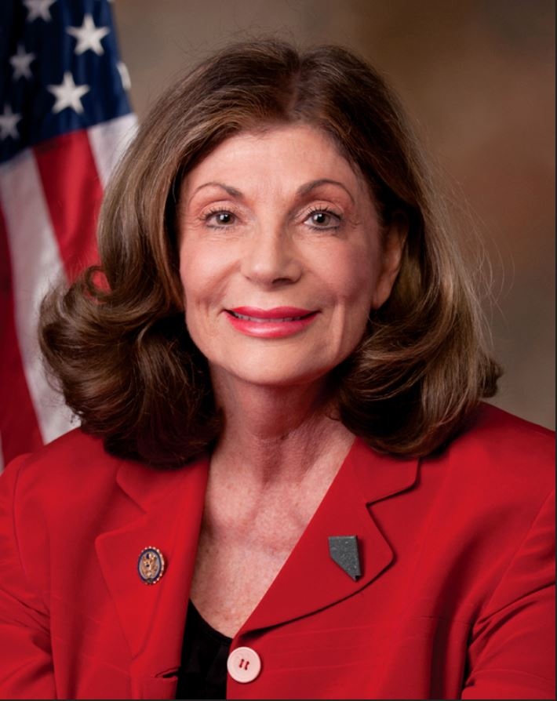
Shelley.Berkley@tun.touro.edu

